Slide 1

Mini Project-II (K24MCA18P) Even Semester Session 2024-25
Little Tales
Devanshi Singhal and 202410116100060
Dhwani Panchal and 202410116100063
Deepanshu Ruhela and 202410116100056
Project Supervisor:
Dr. Vipin Kumar
Professor

Slide 2
Content
Introduction
Literature Review
Objective of the Project
Technology
Hardware Requirements
Software Requirements
Modules
Workflow
Reports
References

Slide 3
Introduction
Storytelling is a vital tool for children's learning and development, yet parents face challenges in making it inclusive and engaging. Traditional methods often exclude differently-abled children, limiting their participation. Additionally, diverse learning paces require adaptive storytelling, which many current tools lack.
Technology offers solutions, but accessibility and personalization remain hurdles, making it difficult for parents to foster creativity and cognitive growth. Balancing entertainment with education is another struggle, as engaging stories must also provide meaningful learning outcomes.
This project aims to create an interactive, inclusive, and adaptive storytelling experience, addressing these challenges through technology-driven solutions.

Slide 4
Literature Review
Storytelling is essential for child development, enhancing creativity, language skills, and emotional intelligence. According to Vygotsky’s Zone of Proximal Development (ZPD), guided storytelling improves learning outcomes. However, traditional storytelling lacks inclusivity, engagement, and interactivity, limiting its effectiveness.
AI-driven storytelling integrates gamification, NLP, and adaptive learning, making narratives more interactive. While existing apps like Epic! and Storyberries offer digital libraries, they lack AI-based personalization and accessibility features, highlighting the need for an inclusive storytelling platform.

Slide 5
Literature Review (Contd.)
The demand for EdTech solutions is rising, with the global educational technology market projected to reach $404 billion by 2025. The project integrates Java with AI tools such as OpenAI GPT for dynamic story generation, Google Dialog flow for voice interactions, IBM Watson for text-to-speech accessibility.
The project aligns with UN Sustainable Development Goal 4 (Quality Education), ensuring equitable, inclusive learning.
With strong market demand, scalable technology, and sustainable financial models, this AI-powered storytelling app is technically and commercially feasible for development.

Slide 6
Objective of the Project
This project aims to develop an interactive storytelling app using Java and related technologies to enhance learning, engagement, and accessibility for children. The app will feature a Java-based backend (Spring Boot), JavaFX UI, and MongoDB storage for seamless performance.
Key Goals:
Interactive storytelling with decision-based narratives and real-time engagement using Java multithreading.
Accessibility features like text-to-speech (IBM Watson API) and multimedia support for inclusivity.
Parental dashboards for real-time progress tracking and personalized learning insights.
By leveraging Java’s capabilities, this project ensures a robust, scalable, and inclusive storytelling platform.

Slide 7
Technology (Hardware Requirements)
User Devices: Tablets or smartphones (Android/iOS) with touch-screen support for interactive storytelling.
Laptops or desktops for progress tracking and content customization.
Server Infrastructure: Cloud-based hosting for scalability and seamless content delivery.
High-performance database servers for storing user progress, preferences, and analytics.
Assistive Technology Integration: Support for screen readers, braille displays, and speech-to-text tools..

Slide 8
Technology (Software Requirements)
Programming Languages & Frameworks:
Java (Spring Boot) – Backend API development.
React.js – Front-end for web and mobile apps.
Node.js – Real-time interactions and event-driven programming.
Database & Cloud Services:
MongoDB / PostgreSQL – Flexible user data storage.
AI & Accessibility Tools:
IBM Watson Text-to-Speech – Assistive narration for differently-abled children.

Slide 9
Modules
1. Authentication & User Management:
Implement Clerk Authentication to enable login via Google, Facebook, and Email.
Manage user sessions securely.
2. User Dashboard:
Display all stories created by the logged-in user.
Show credit balance & usage tracking (1 credit per story creation).
Provide a quick access panel to create new stories or explore existing ones.

Slide 10
Modules
3. Story Creation Module:
User inputs keywords such as:
Subject of the story
Story type (Adventure, Fantasy, Moral, etc.)
Target age group
Image style (AI-generated or predefined)
AI generates the story with both text and audio narration options.
Story preview before finalizing.
4. Story Exploration Module:
Browse a collection of user-generated stories.
Filter by category, age group, popularity, or newest uploads.
Option to like, save, or share stories.

Slide 11
Modules
6. Accessibility Features:
Read Aloud Mode for listening to stories.
Text-to-Speech customization (voice selection, speed adjustment)
Dark Mode/High Contrast Mode for better readability.

Slide 12
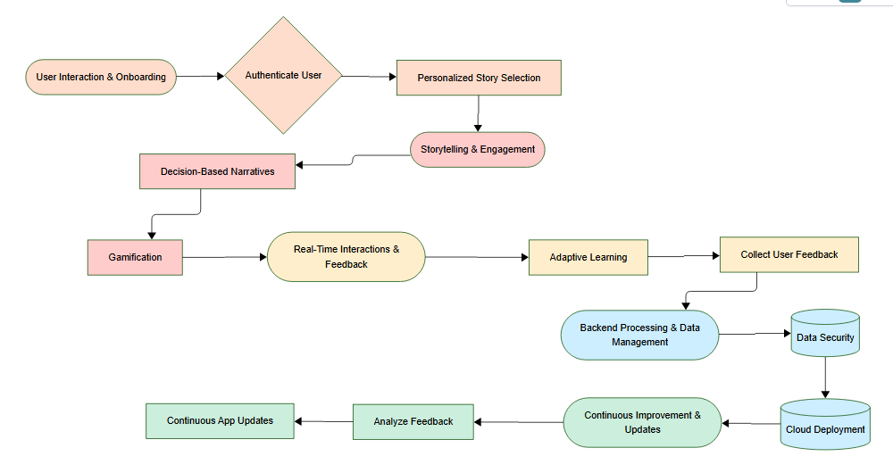
Workflow/Gantt Chart

Slide 13
Reports & Manuals
User Guide for Children:
Navigating the storytelling app
Interacting with AI-generated stories
Parental Dashboard Guide:
Setting learning preferences
Monitoring progress reports
Administrator Guide:
Managing story content
Ensuring accessibility compliances

Slide 14
References
https://www.wikipedia.org/
https://www.microsoft.com/en-us/cognitive-services
https://openai.com/research
https://www.statista.com
https://spring.io/projects/spring-boot
https://openjfx.io
https://www.mongodb.com/spring-boot

